Slide 1


REPRESENTATIVE!
Rebecca Burnett, Ava Nelson, Vanessa Miller, Aurelia Arnett, Teja Sanaka

Slide 2
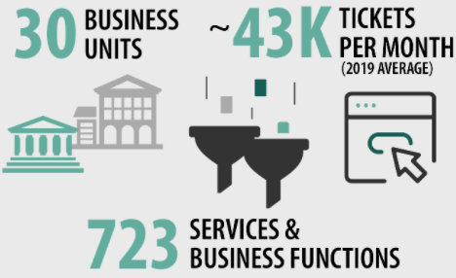
BY THE NUMBERS
SERVICENOW
About the project
The data consists of 2 datasets of ServiceNow technicians providing the same service on two different customer accounts contains ticket information such as date-time opened, total duration opened, ticket category, ticket location, and technician information
This problem is important to our company because by optimizing ticket resolution time you can save the company time and money, streamline the customer experience & expedite troubleshooting problems, and drive customer satisfaction.

Slide 3




Project Goals
Ticket Types
Determine the types of tickets that are opened most frequently by ticket category
Ticket Durations
Determine the length of time to ticket resolution by ticket category
Ticket Locations
Determine where tickets are most frequently opened
Staff
Determine where employees are working tickets geographically
Recommend Staff

Slide 4
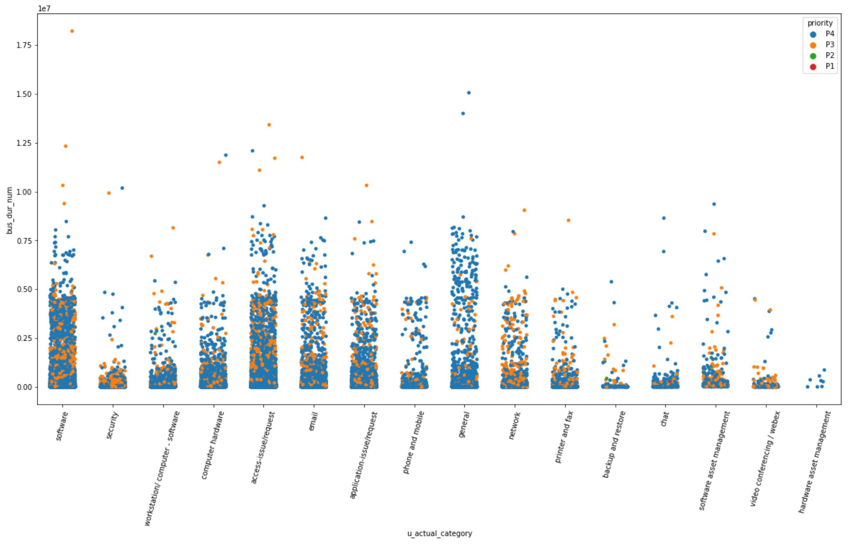
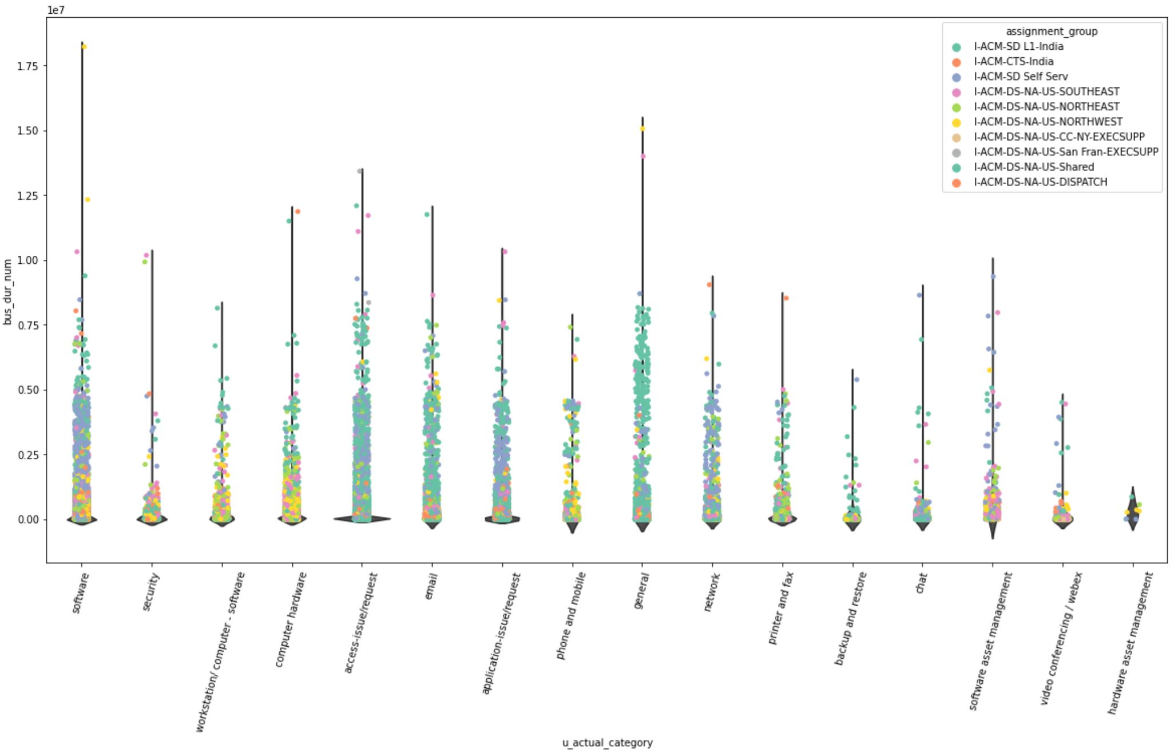
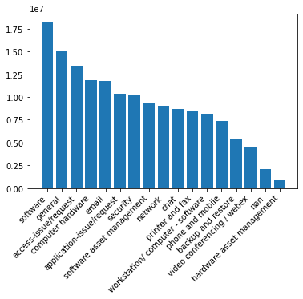
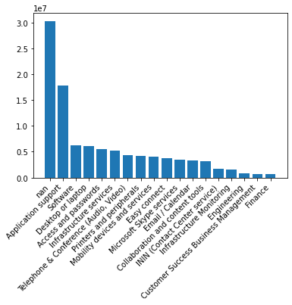
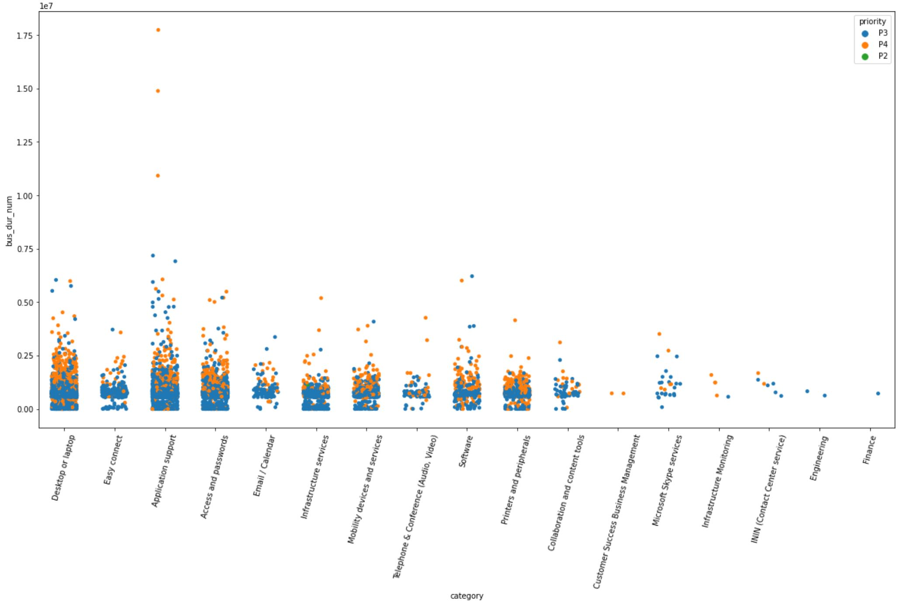
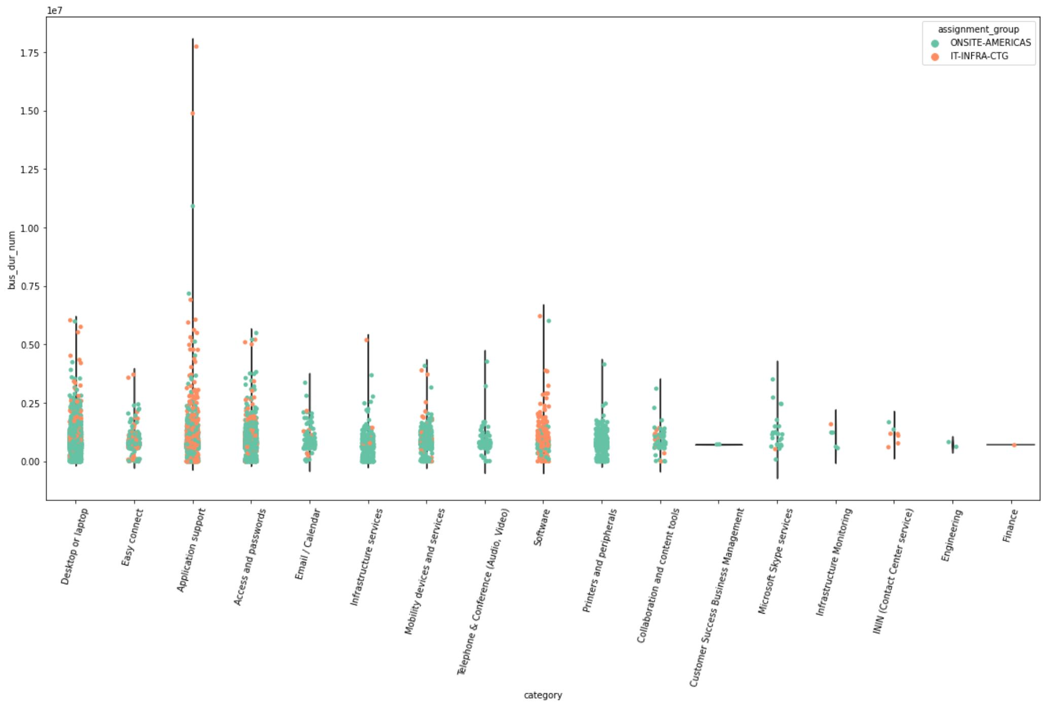
Initial EDA
walk
Categories by distribution
Categories by priority
Categories by teams
Company A
Company A
Company A
Company J
Company J
Company J

Slide 5
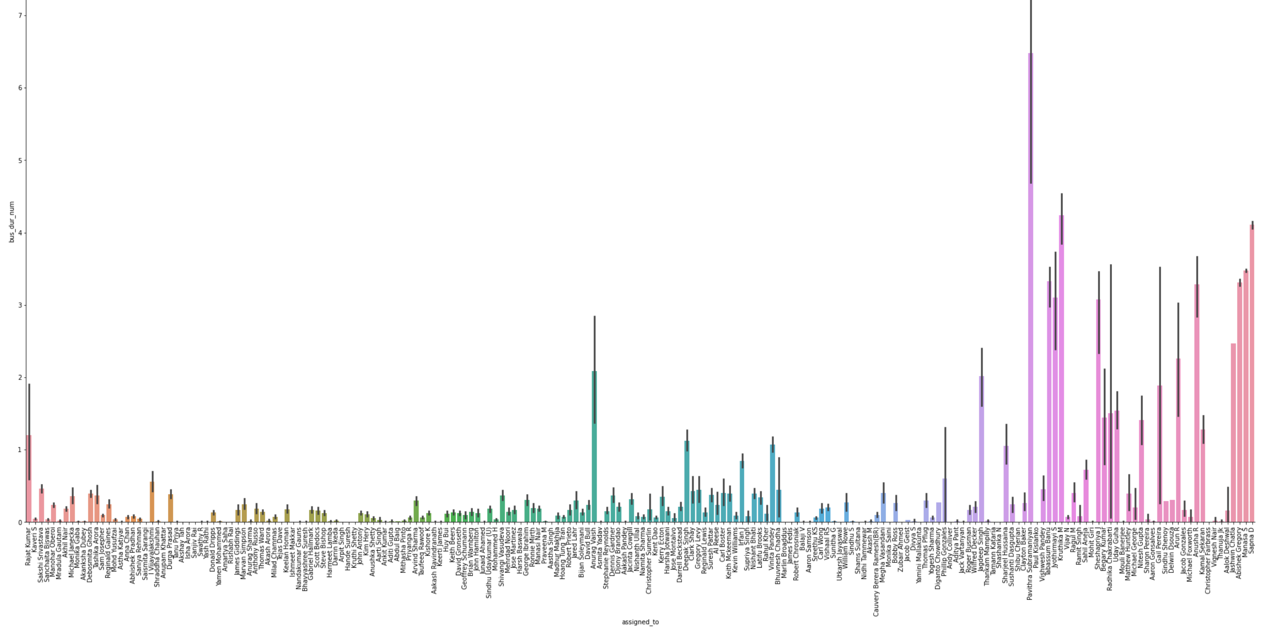
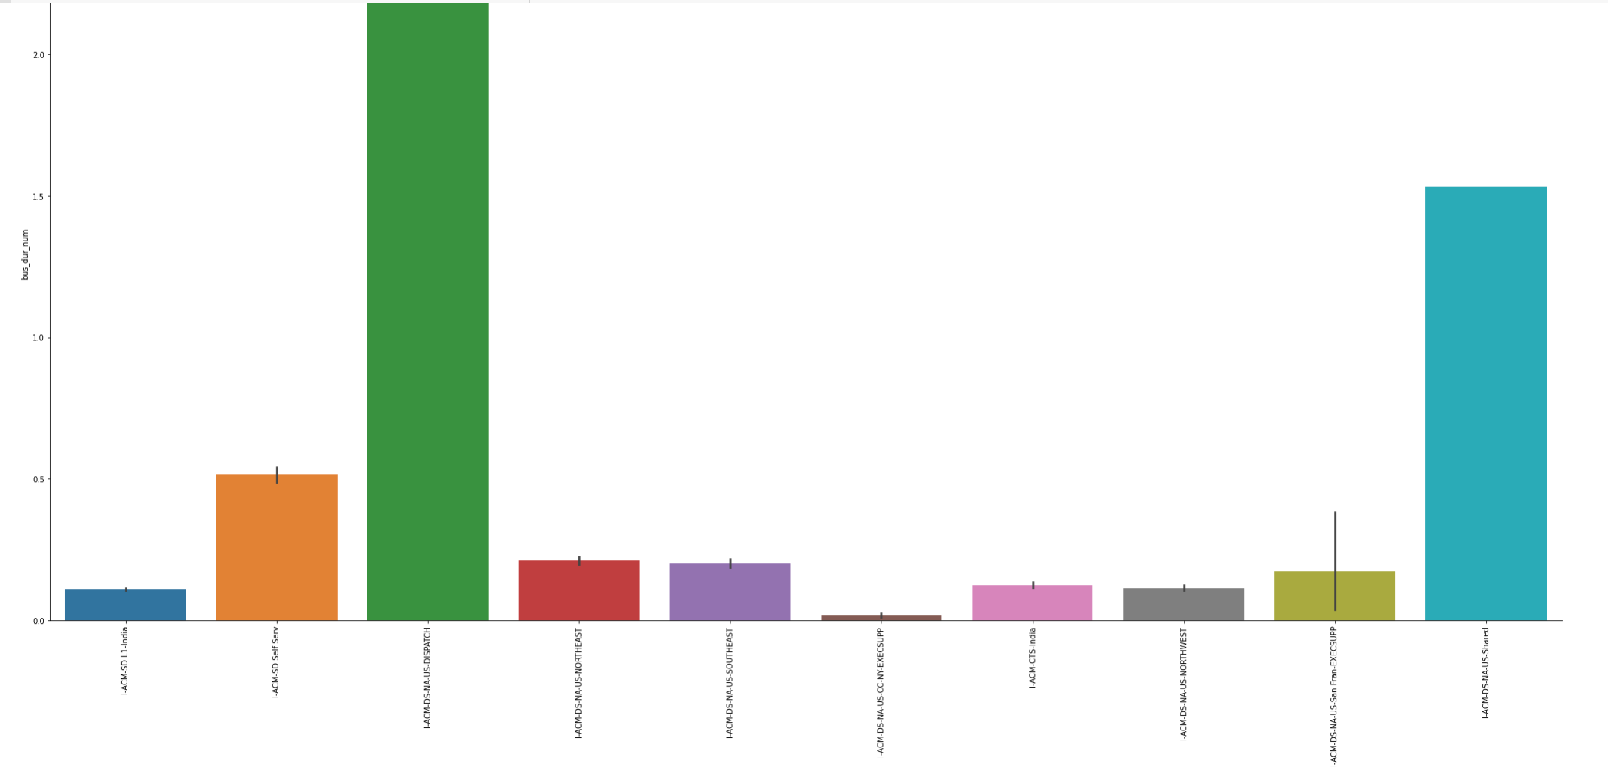
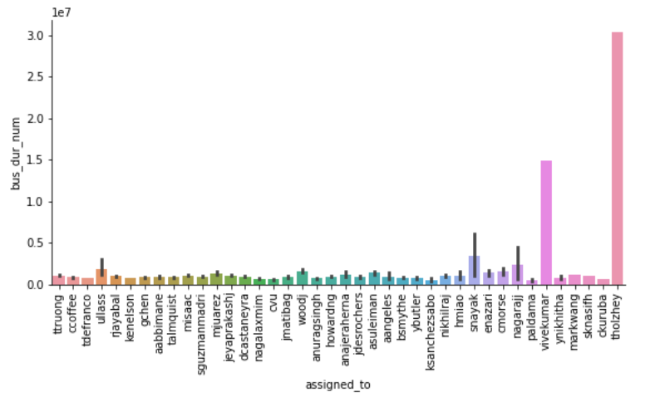
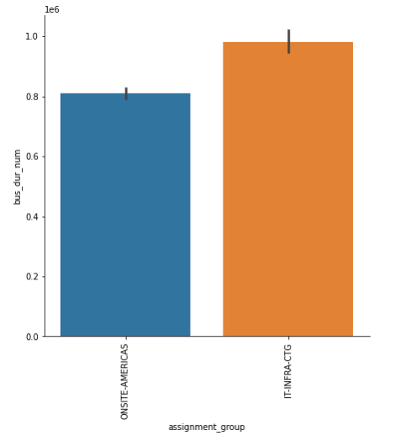
Initial EDA – ticket duration by technician
walk
Company A ticket duration by technician
Company A ticket duration by team
Company J ticket duration by technician
Company J ticket duration by team

Slide 6
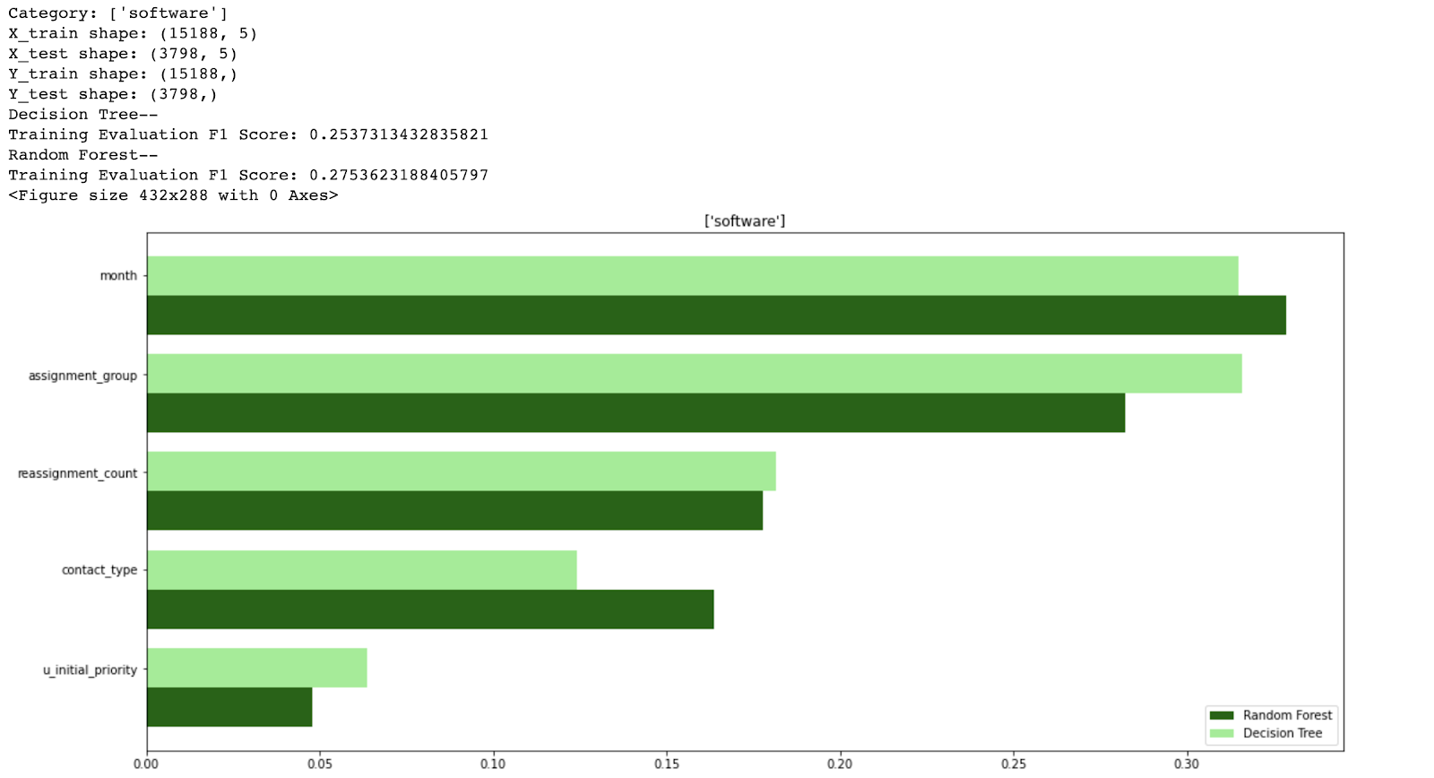
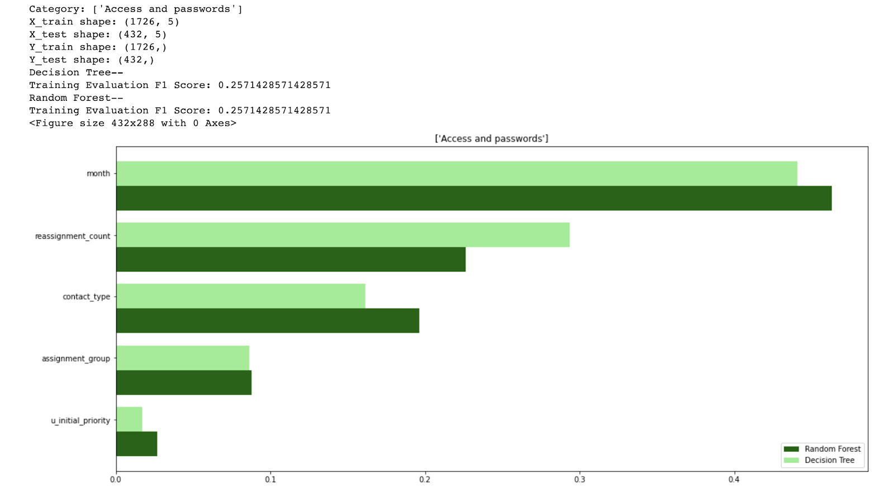
DT/RF for hot categories from outliers company A & J
walk

Slide 7
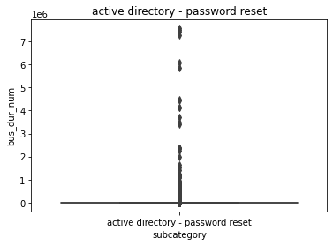
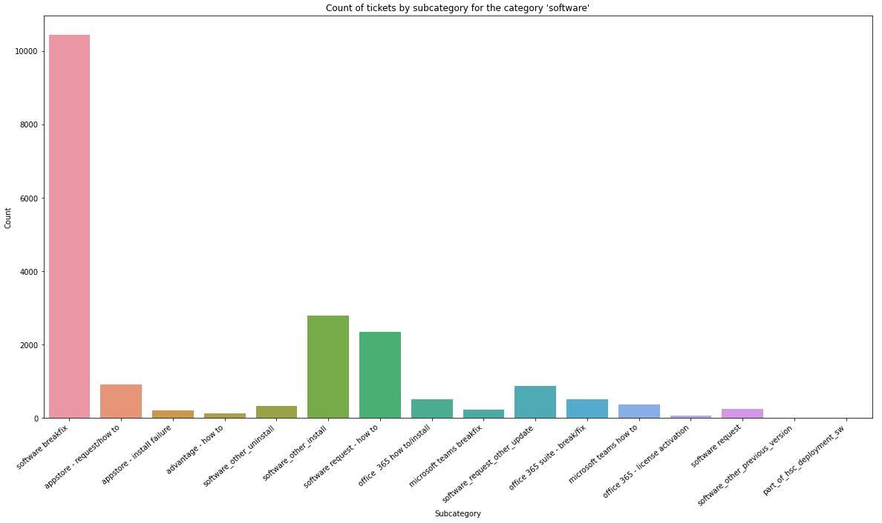
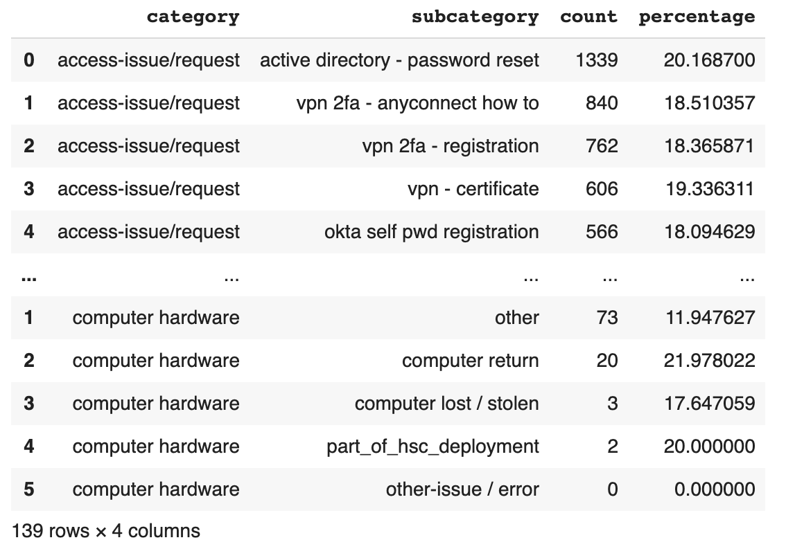
EDA duration of hot subcategories
walk
EDA Count of Hot Subcategories
EDA Duration of Hot Subcategories

Slide 8
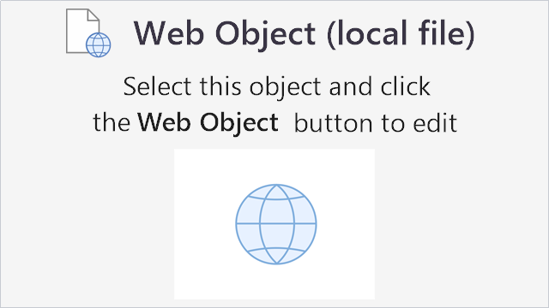
A vs J T-SNE visualization
run

Slide 9
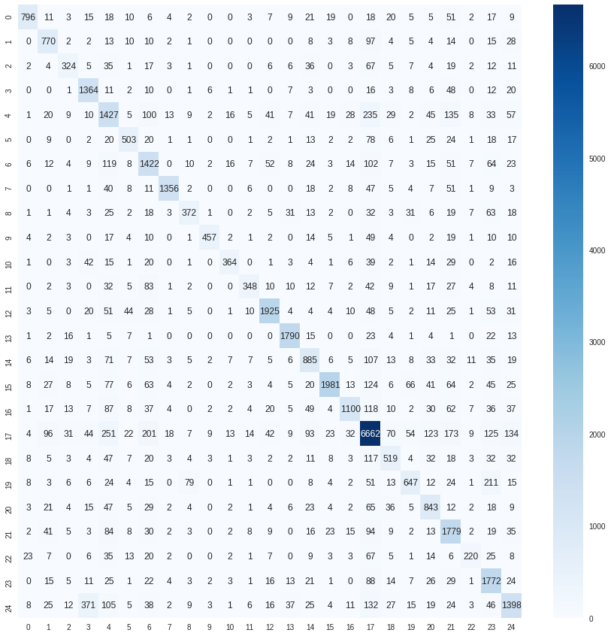
run
Company A – Topic Model Testing
Accuracy Classification Score 71.21%
Random Forest Classifier Score 76.28%
Accuracy Bag of Words 74.52%
Accuracy for TFIDF 74.53%

Slide 10
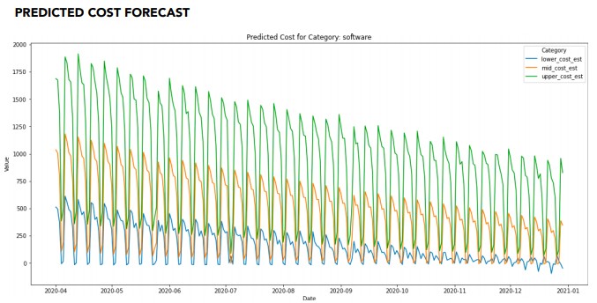
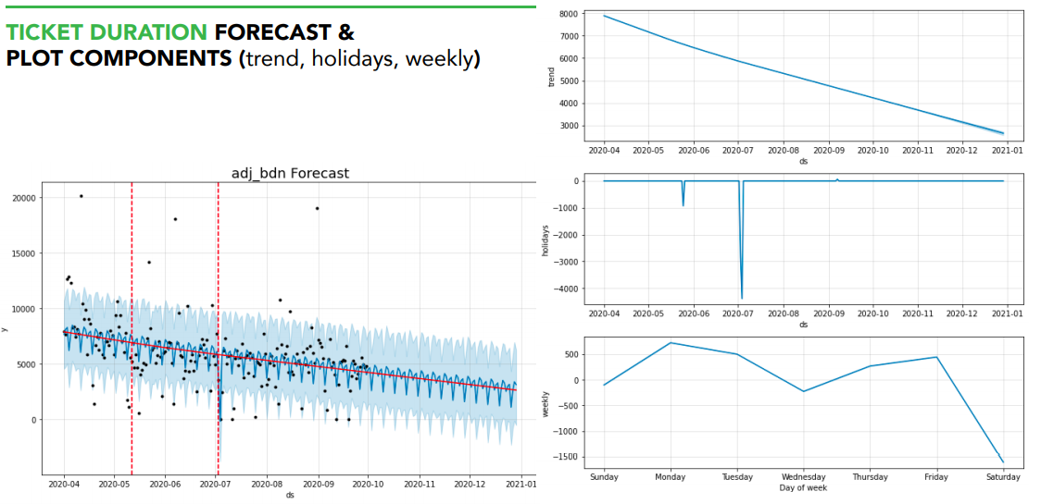
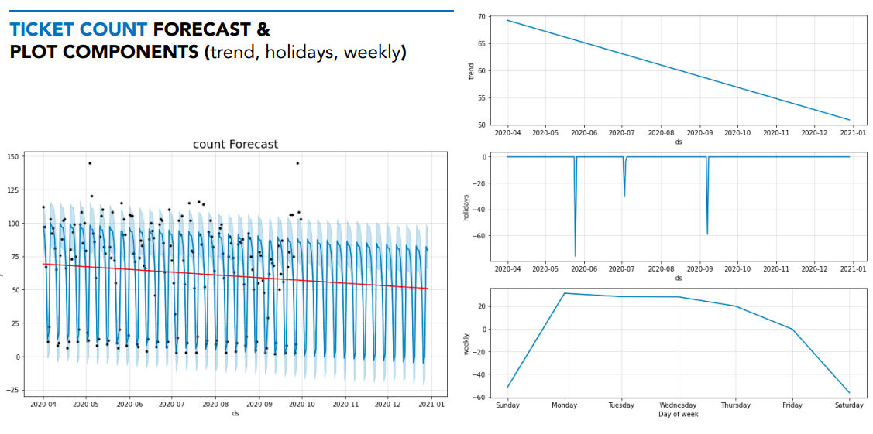
Modeling: prophet on categories
run

Slide 11
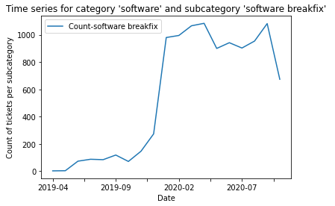
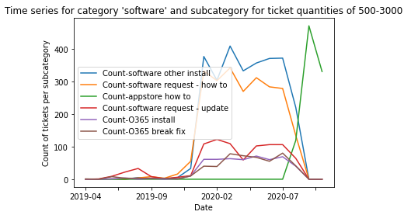
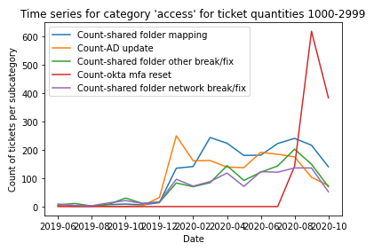
Modeling: Company A timeseries on subcategories
run

Slide 12
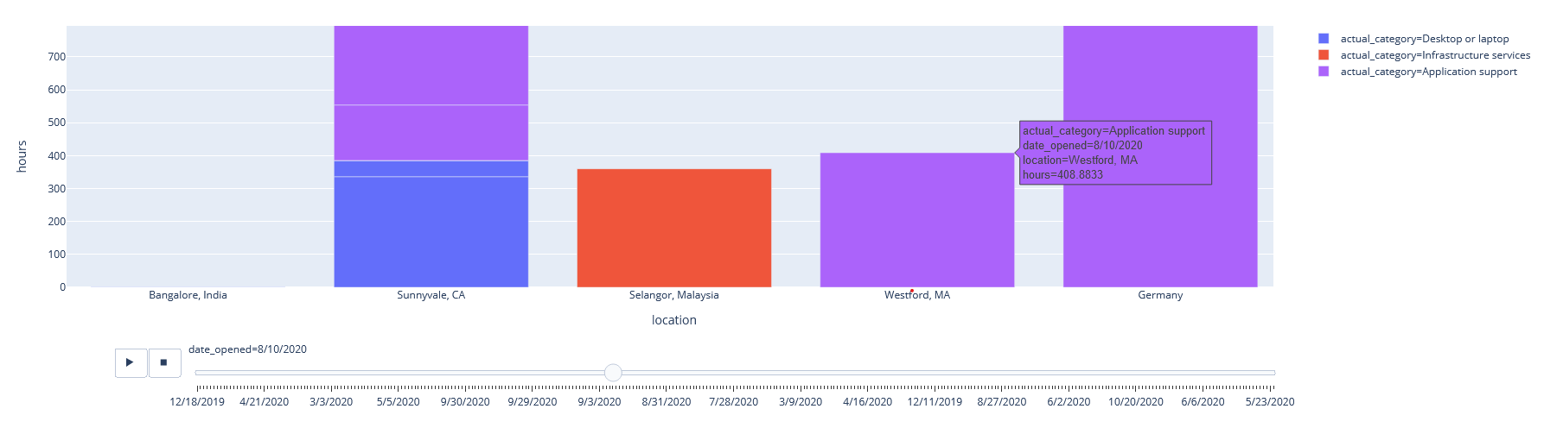
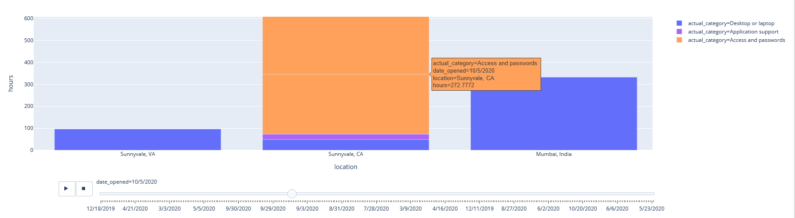
Modeling: location –Animated Time Analysis
Company A
Company J

Slide 13
Modeling: location – ticket duration by open location
run
Company A
Company J

Slide 14
Modeling: location- location closed (heatmap)
run

Slide 15
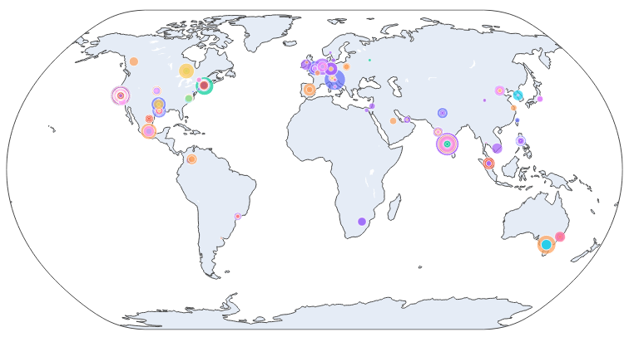
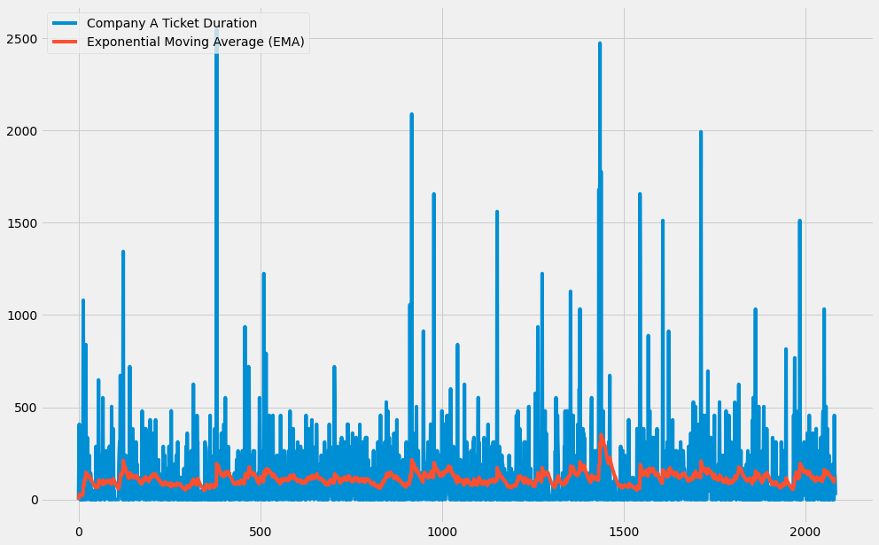
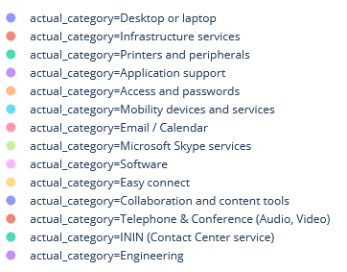
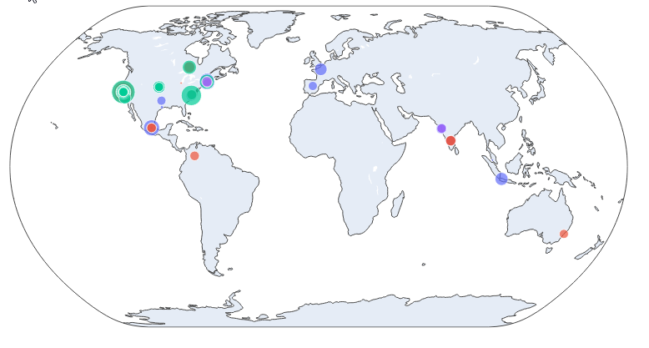
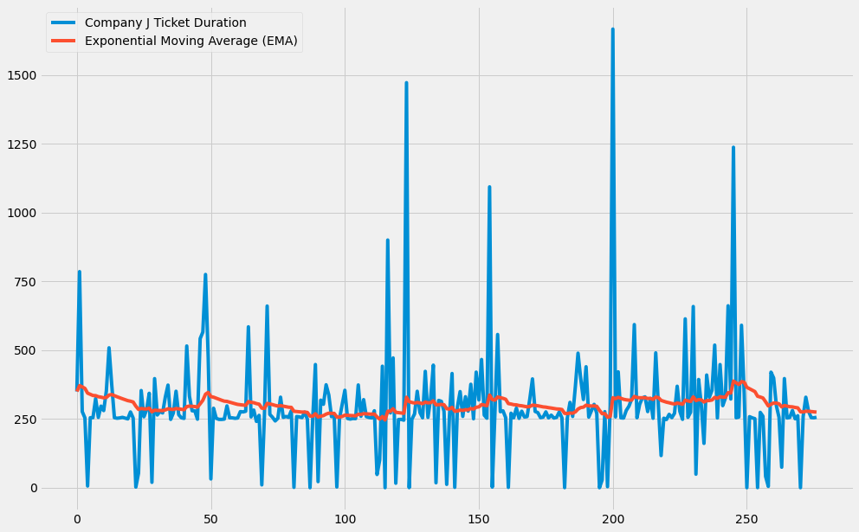
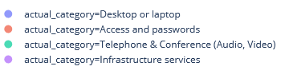
Modeling: location – location of outliers by company
run
Company A
Company J

Slide 16
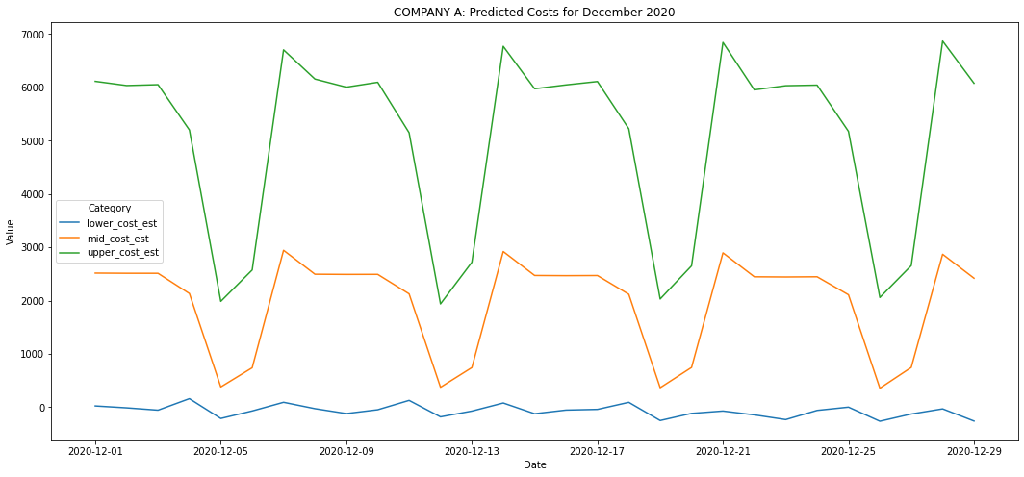
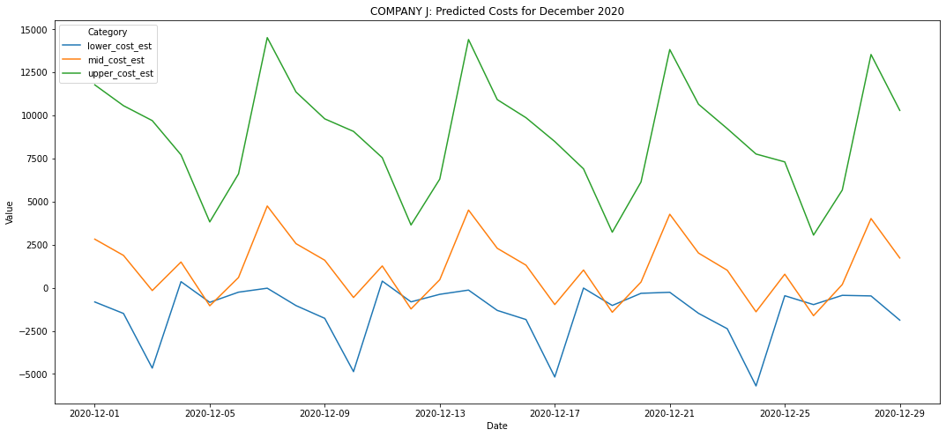
Recommendation – December Budget
$56,756.66
$32,610.57

Slide 17
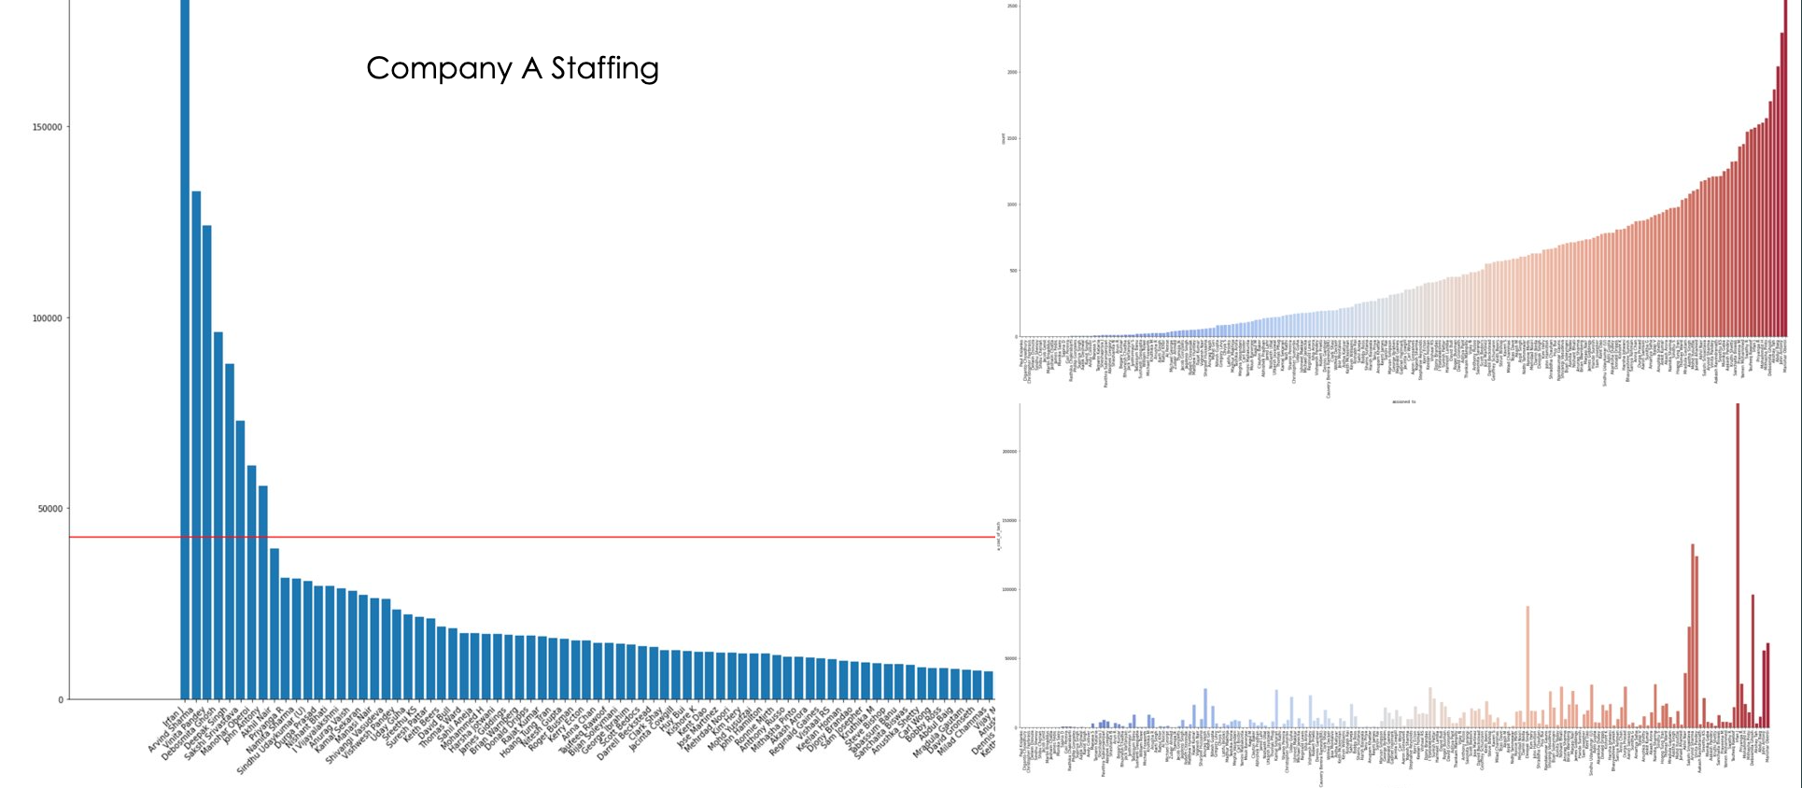
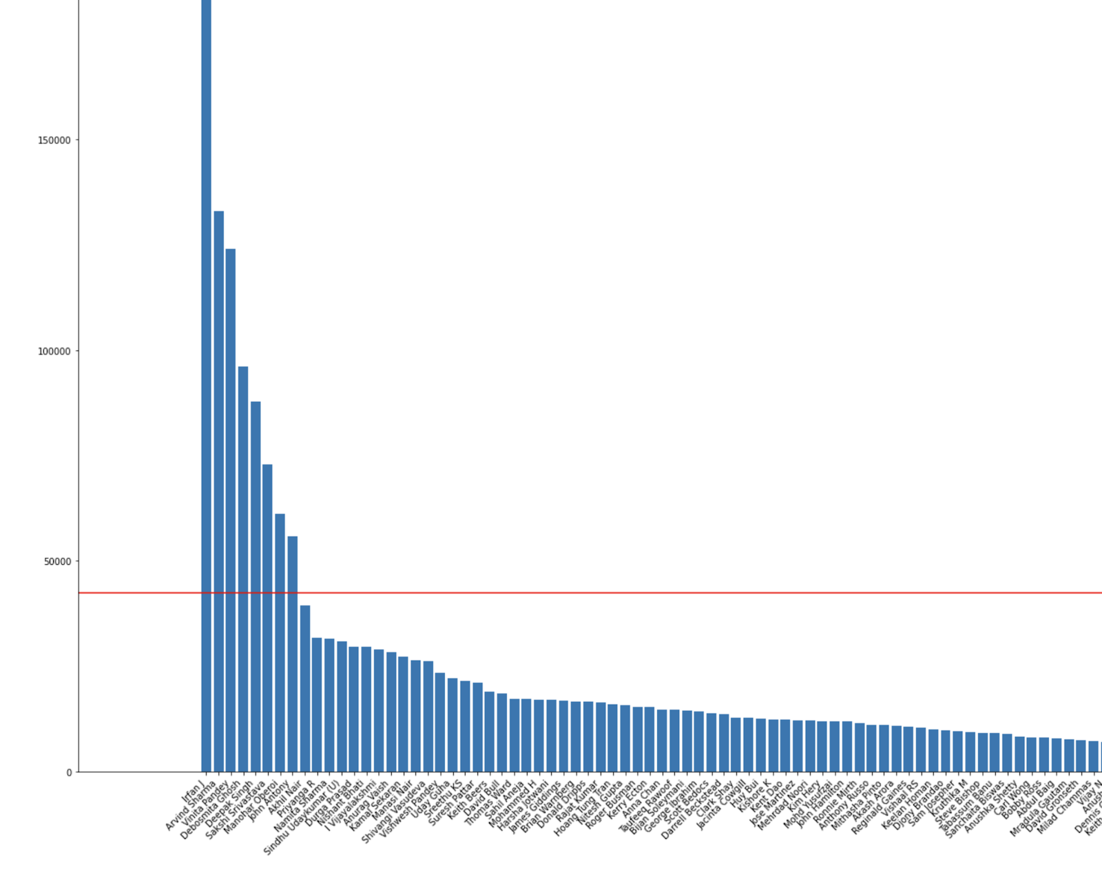
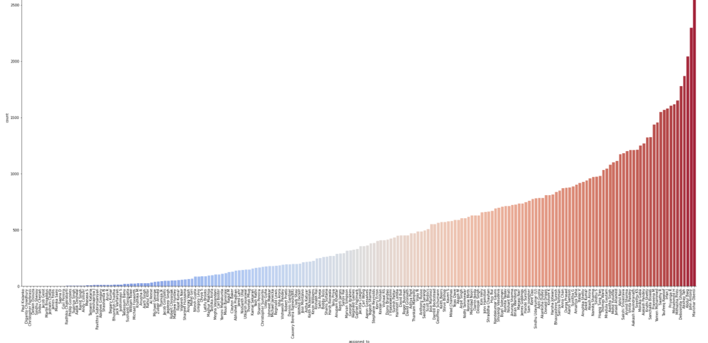
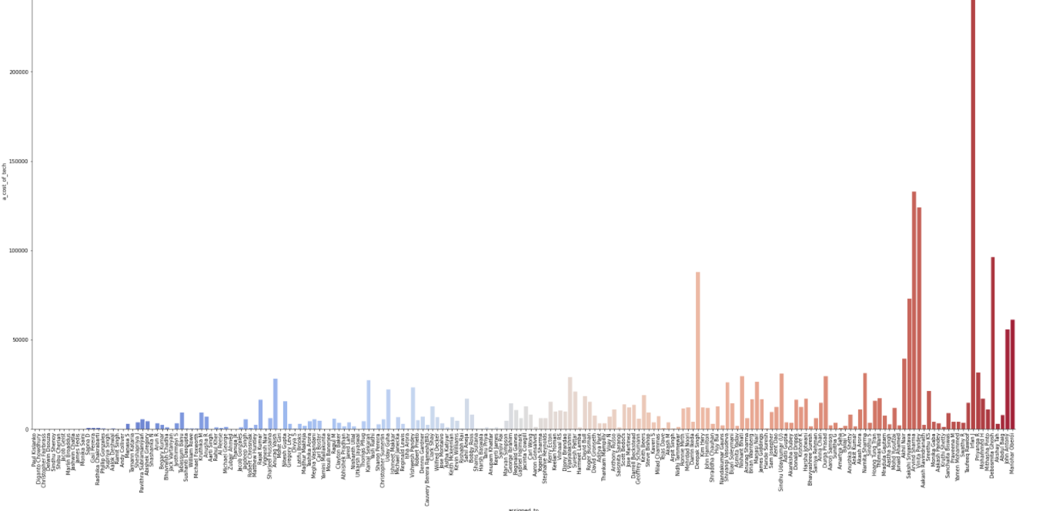
Recommendation – December Staffing
Company A Staffing

Slide 18
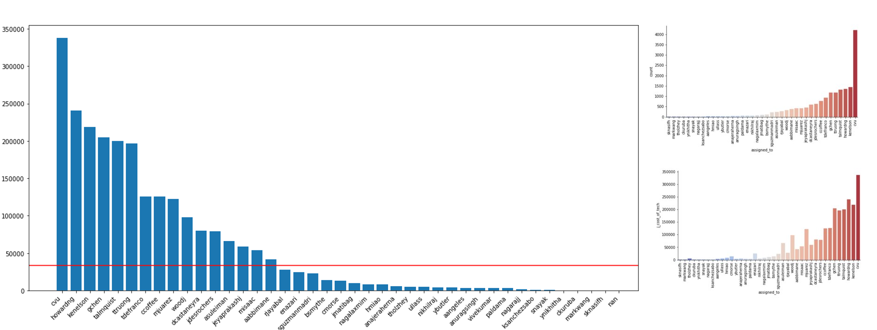
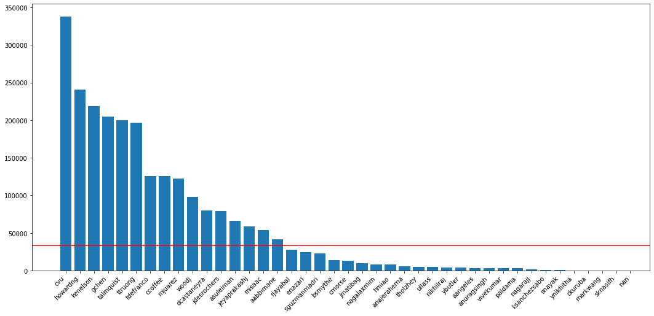
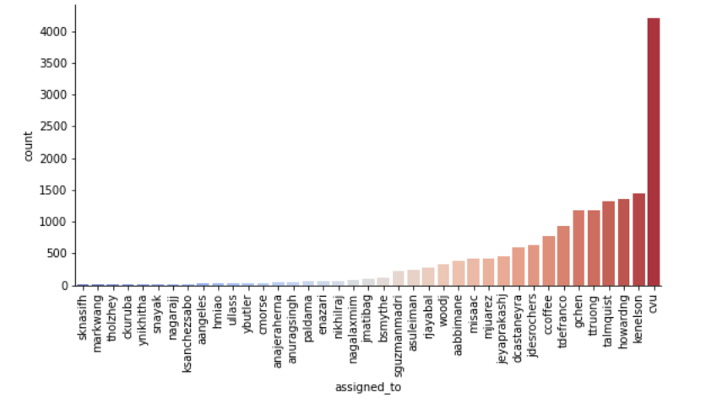
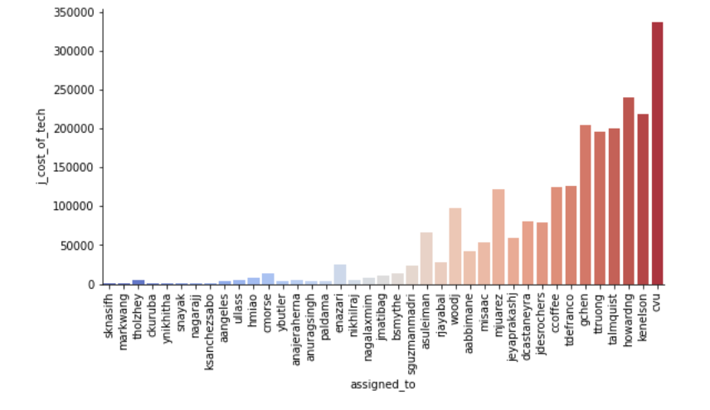
Recommendation – December Staffing
Company J Staffing

Slide 19
Presentation Flow
Initial EDA
Categories by priority
Categories by assignment groups
Classification models on outliers
EDA: Duration of hot subcategories (box plots)
EDA: Count of hot subcategories (bar chart)
Modeling: Prophet on categories
Modeling: Timeseries of subcategories
Modeling: location (GSI)
Modeling: employees (GSI)
Recommendation
Notes:
https://www.carahsoft.com/servicenow
Deck template: https://www.servicenow.com/content/dam/servicenow/other-documents/investor-relations/investor-presentations/servicenow-q2-2020-investor-presentation.pdf
By the numbers: https://uit.stanford.edu/sites/default/files/snow-infographic-vs5-01.png

